Slide 1
Computer Networks
Autumn 2022

Slide 2
Overview
Introduction: course description ( Why to learn? What to learn? How to learn?)
Answers to frequently asked questions

Slide 5

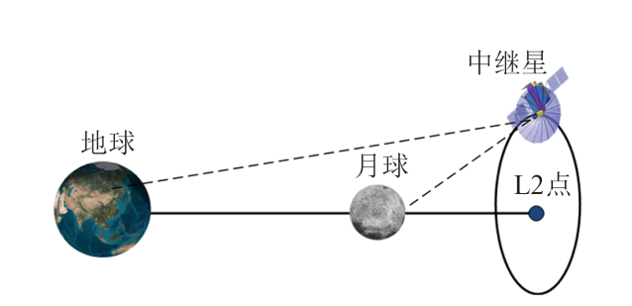
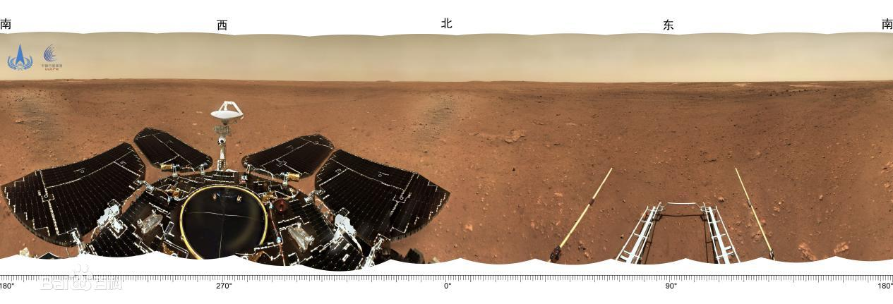
通过鹊桥传回的月球背面图像 鹊桥中继星的作用
祝融号火星车传回的图像

Slide 6

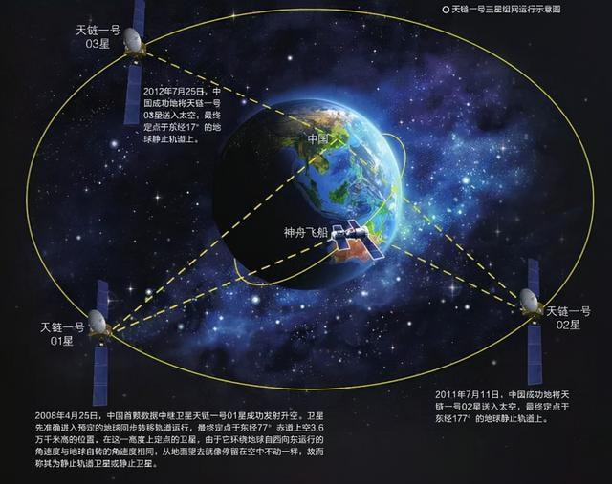
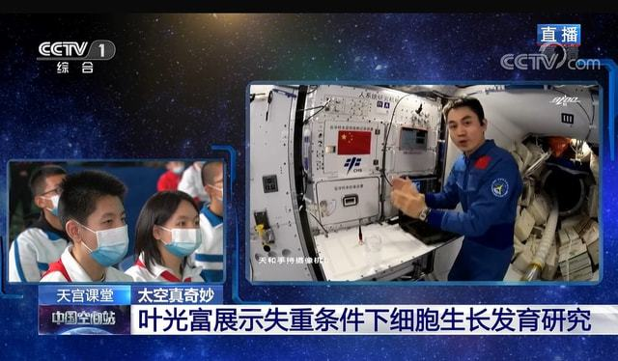
“天宫课堂”第一课开讲
天链一号实现全球无缝链接通信

Slide 7
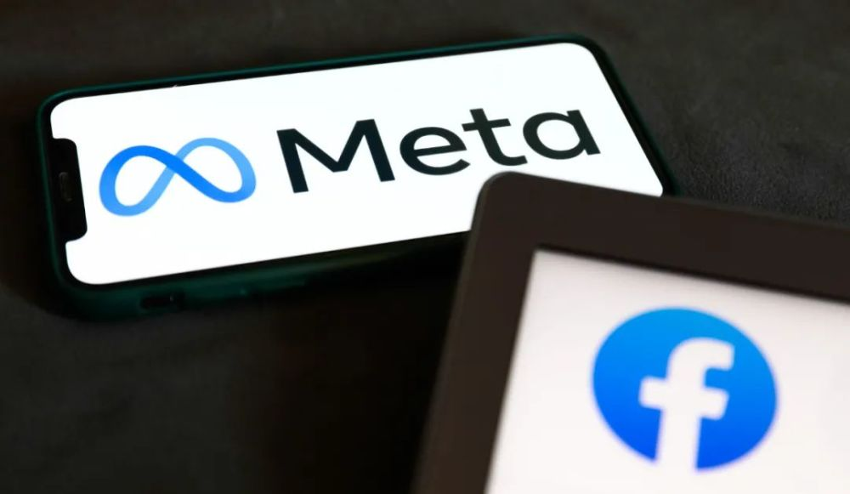
Metaverse一词在2021年12月，入选《柯林斯词典》2021年度热词；
12月6日，入选“2021年度十大网络用语”；
12月8日，入选《咬文嚼字》“2021年度十大流行语”。

Slide 8
Overview
Introduction: course description ( Why to learn? What to learn? How to learn?)
Answers to frequently asked questions

Slide 9
Course Grading
Textbook
1.Computer Networking: A Top Down Approach, 7th ed., Pearson/Addison Wesley
2.计算机网络:自顶向下方法, 原书第7版, 机械工业出版社
3.何顶新，郑定富，胡晓娅. 计算机网络及应用，北京：化学工业出版社，2011.06
Assignments (experiment + homework ）+ attendance
30%
Final 70%

Slide 10
Chapter 1: introduction
Overview:
Terminology and Concepts related to
“ Computer Network”
use Internet as example
What’s a protocol?
Protocol layers and their service models
Internet history
Keypoints:
Protocol and three essential factors
Protocol layers and layered architecture
Difficulties:
Connection-oriented and connectionless
Circuit switching and packet switching
Delay and how to calculate the delay

Slide 11
Chapter 1: roadmap
1.1 What is the Internet?
1.2 Network edge
hosts, access network, physical media
1.3 Network core
packet switching, circuit switching, network structure
1.4 Delay & loss in packet-switched networks
1.5 Protocol layers, Service models
1.6* Internet history
Notes:
11

Slide 12
















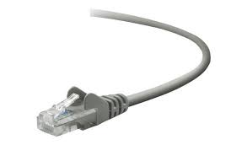
What’s the Internet: “nuts and bolts” view
Billions of connected computing devices:
hosts = end systems
running network apps at Internet’s “edge”
mobile network
national or global ISP
Packet switches: forward packets (chunks of data)
routers, switches
local or regional ISP
Internet
Communication links
fiber, copper, radio, satellite
transmission rate: bandwidth
home network
content
provider
network
datacenter
network
Networks
collection of devices, routers, links: managed by an organization
enterprise
network
Notes:
12
螺母螺栓，具体细节
Packet分组

Slide 13





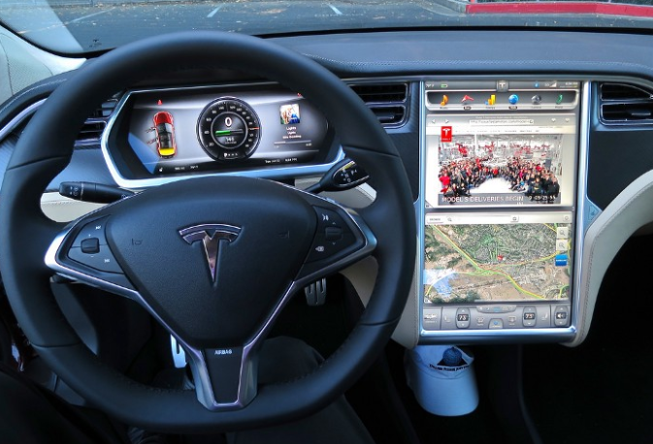




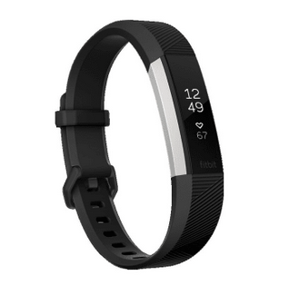


“Fun” Internet-connected devices
Pacemaker & Monitor
scooters
Amazon Echo
IP picture frame
bikes
Internet
refrigerator
Slingbox: remote
control cable TV
cars
Security Camera
Tweet-a-watt:
monitor energy use
AR devices
Internet phones
Fitbit

Slide 14
What’s the Internet: “nuts and bolts” view
Internet: “network of networks”
Interconnected ISPs
4G
national or global ISP
IP
Streaming
video
protocols are everywhere
control sending, receiving of messages
e.g., HTTP (Web), TCP, IP, WiFi,
streaming video, Skype, 4G, Ethernet
Skype
local or regional ISP
home network
content
provider
network
HTTP
datacenter
network
Internet standards
RFC: Request for Comments
IETF: Internet Engineering Task Force
Ethernet
TCP
enterprise
network
WiFi

Slide 15
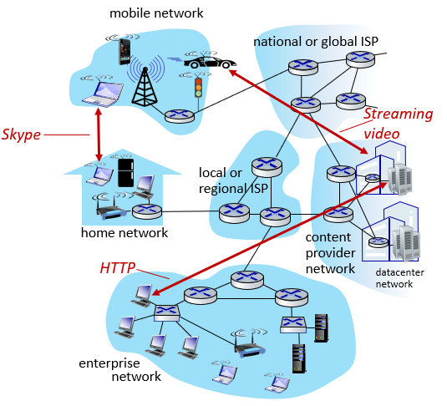
What’s the Internet: a service view
Infrastructure that provides services to applications:
Web, streaming video, multimedia teleconferencing, email, games,
e-commerce, social media,
inter-connected appliances, …
provides programming interface to distributed applications:
“hooks” allowing sending/receiving apps to “connect” to, use Internet transport service
provides service options,
analogous to postal service

Slide 16
Chapter 1: roadmap
1.1 What is the Internet?
1.2 Network edge
hosts, access network, physical media
1.3 Network core
packet switching, circuit switching, network structure
1.4 Delay & loss in packet-switched networks
1.5 Protocol layers, Service models
1.6* Internet history
Notes:
16

Slide 17
A closer look at network structure:
mobile network
Network edge:
hosts (End systems):
Run application programs
e.g. Web, email
At “edge of network”
clients and servers
Client/server model
Client host requests, receives service from always-on server
E.g. Web browser/server; email client/server
Peer-to-peer model
Minimal (or no) use of dedicated servers
E.g. Skype, BitTorrent, KaZaA
national or global ISP
local or regional ISP
home network
content
provider
network
datacenter
network
enterprise
network

Slide 18
A closer look at network structure:
Network edge:
hosts: clients and servers
servers often in data centers
Access networks, physical media:
wired, wireless communication links
mobile network
national or global ISP
local or regional ISP
home network
content
provider
network
datacenter
network
enterprise
network

Slide 19
A closer look at network structure:
mobile network
Network edge:
hosts: clients and servers
servers often in data centers
Access networks, physical media:
wired, wireless communication links
Network core:
interconnected routers
network of networks
national or global ISP
local or regional ISP
home network
content
provider
network
datacenter
network
enterprise
network

Slide 20
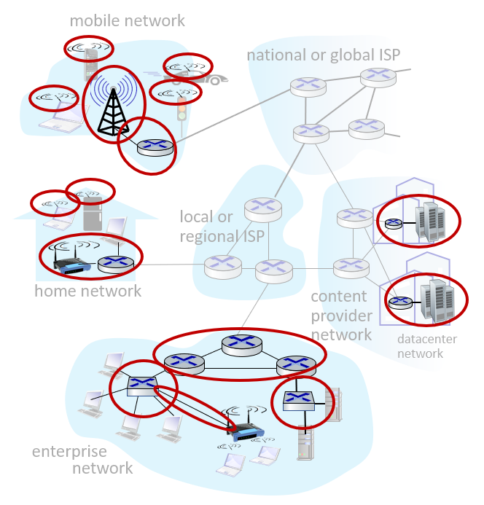
Access networks and physical media
Q: How to connect end systems to edge router?
residential access nets
institutional access networks (school, company)
mobile access networks
(WiFi, 4G/5G)
What to look for:
bandwidth (bits per second) of access network?
shared or dedicated?

Slide 21
Residential Access: Point to Point Access
Dialup via modem
Up to 56Kbps direct access to router (often less)
Can’t surf and phone at same time: can’t be “always on”
ADSL: asymmetric digital subscriber line
Up to 1 Mbps upstream (today typically < 256 kbps)
Up to 8 Mbps downstream (today typically < 1 Mbps)
HFC: hybrid fiber coax
Asymmetric: up to 30Mbps downstream, 2 Mbps upstream
Is shared broadcast medium

Slide 22








Access network: home network
wireless
devices
to/from headend or central office
often combined
in single box
modem
wireless access
point (54 Mbps)
router, firewall, NAT
wired Ethernet (1 Gbps)

Slide 23
Access network: home network

Slide 24









Enterprise access networks (Ethernet)
institutional link to
ISP (Internet)
institutional router
Ethernet
switch
institutional mail,
web servers
typically used in companies, universities, etc.
10 Mbps, 100Mbps, 1Gbps, 10Gbps transmission rates
today, end systems typically connect into Ethernet switch

Slide 25








Wireless access networks
shared wireless access network connects end system to router
via base station aka “access point”
wide-area wireless access
provided by telco (cellular) operator, 10’s km
between 1 and 10 Mbps
3G, 4G: LTE，5G
wireless LANs:
within building (100 ft.)
802.11b/g/n/ac/ax (WiFi):
11, 54, 450 Mbps transmission rate
to Internet
to Internet

Slide 26
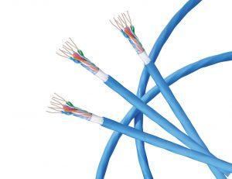
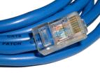
Physical media
bit: propagates between transmitter/receiver pairs
physical link: what lies between transmitter & receiver
guided media:
signals propagate in solid media: copper, fiber, coax
unguided media:
signals propagate freely, e.g., radio
twisted pair (TP)
two insulated copper wires
Category 5: 100 Mbps, 1 Gbps Ethernet
Category 6: 10Gbps

Slide 27
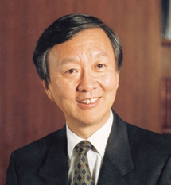

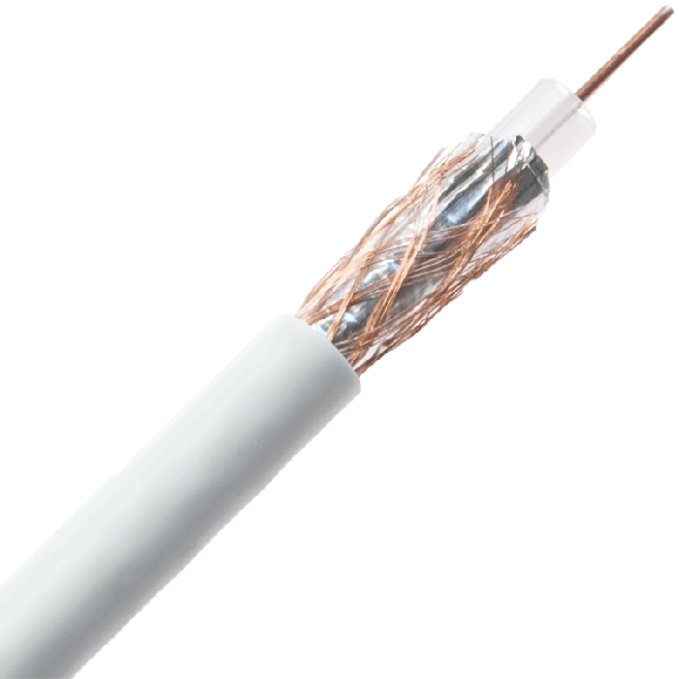
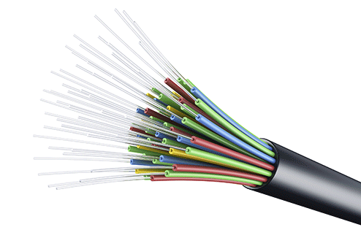
Physical media: coax, fiber
coaxial cable:
two concentric copper conductors
bidirectional
broadband:
multiple channels on cable
HFC
fiber optic cable:
glass fiber carrying light pulses, each pulse a bit
high-speed operation:
high-speed point-to-point transmission (e.g., 10’s-100’s Gbps transmission rate)
low error rate:
repeaters spaced far apart
immune to electromagnetic noise
长飞、亨通光电、烽火
中国光谷已成长为中国最大的光纤光缆、光电器件生产基地，最大的光通信技术研发基地。

Slide 28
Physical media: radio
signal carried in electromagnetic spectrum
no physical “wire”
bidirectional
propagation environment effects:
reflection
obstruction by objects
interference
radio link types:
terrestrial microwave
e.g. up to 45 Mbps channels
LAN (e.g., WiFi)
54 Mbps
wide-area (e.g., cellular)
4G cellular: ~ 10 Mbps
satellite
Kbps to 45Mbps channel (or multiple smaller channels)
270 msec end-end delay
geosynchronous versus low altitude

Slide 29
Chapter 1: roadmap
1.1 What is the Internet?
1.2 Network edge
hosts, access network, physical media
1.3 Network core
packet switching, circuit switching, network structure
1.4 Delay & loss in packet-switched networks
1.5 Protocol layers, Service models
1.6* Internet history
Notes:
29

Slide 30
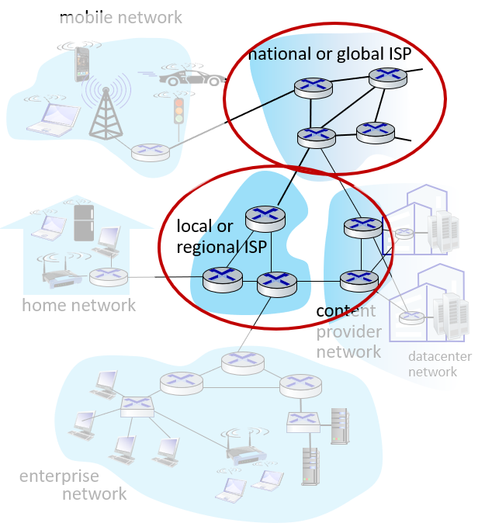
The network core
mesh of interconnected routers
The fundamental question: how is data transferred through net?
Circuit-switching: dedicated circuit per call: telephone net
Packet-switching: data sent through net in discrete “chunks”

Slide 31
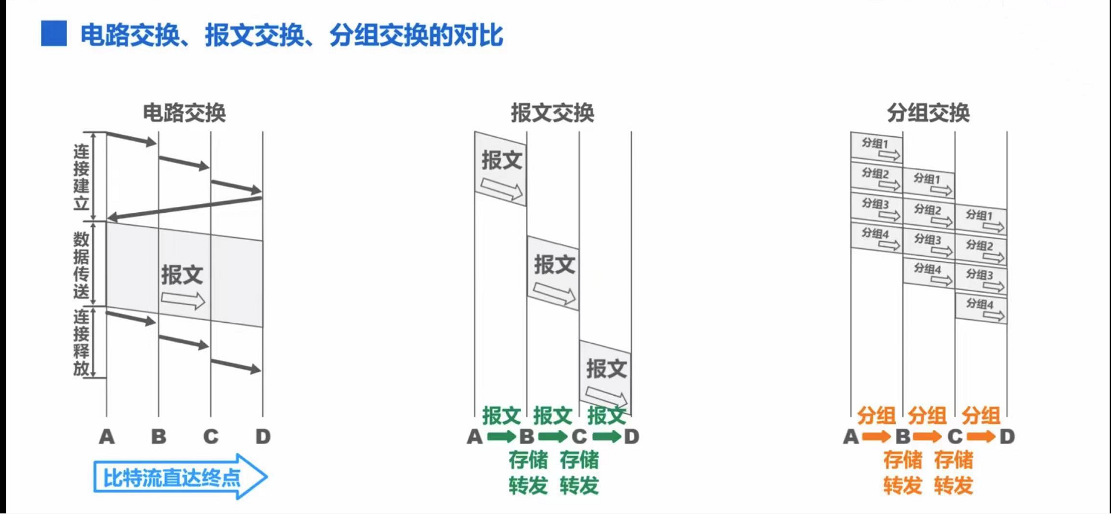
The network core
Message switching and Packet-Switching: Store-and-Forward

Slide 32
Circuit Switching
End-end resources reserved for “call”
Link bandwidth, switch capacity
Dedicated resources: no sharing
Circuit-like (guaranteed) performance
Call setup required

Slide 33
Circuit Switching
Network resources (e.g., bandwidth) divided into “pieces”
Pieces allocated to calls
Resource piece idle if not used by owning call (no sharing)
Dividing link bandwidth into “pieces”
Frequency division
Time division

Slide 34
Circuit switching: FDM versus TDM
Example:
FDM
4 users
frequency
time
TDM
frequency
time
Notes:
Two simple multiple access control techniques.
Each mobile’s share of the bandwidth is divided into portions for the uplink and the downlink. Also, possibly, out of band signaling.
As we will see, used in AMPS, GSM, IS-54/136

Slide 35
Numerical Example
How long does it take to send a file of 640,000 bits from host A to host B over a circuit-switched network?
All links are 1.536 Mbps
Each link uses TDM with 24 slots
500 msec to establish end-to-end circuit
Work it out!
Notes:
1536000/24=64000 10s+0.5

Slide 36
Network Core: Packet Switching
Each end-end data stream divided into packets
User A, B packets share network resources
Each packet uses full link bandwidth
Resources used as needed
Resource contention:
Aggregate resource demand can exceed amount available
Congestion: packets queue, wait for link use
Store and forward: packets move one hop at a time
Node receives complete packet before forwarding
Bandwidth division into “pieces”
Dedicated allocation
Resource reservation

Slide 37
Packet Switching: Statistical Multiplexing
100 Mb/s
Ethernet
A
C
statistical multiplexing
1.5 Mb/s
B
queue of packets
waiting for output
link
D
E
Sequence of A & B packets does not have fixed pattern, shared on demand statistical multiplexing
TDM: each host gets same slot in revolving TDM frame

Slide 38

Host: sends packets of data
host sending function:
takes application message
breaks into smaller chunks, known as packets, of length L bits
transmits packet into access network at transmission rate R
link transmission rate, aka link capacity, aka link bandwidth
two packets,
L bits each
2
1
R: link transmission rate
host
packet
transmission
delay
time needed to
transmit L-bit
packet into link
L (bits)
R (bits/sec)
=
=

Slide 39



Packet-switching: store-and-forward
L bits
per packet
source
3
2
1
R bps
R bps
destination
Transmission delay: takes L/R seconds to transmit (push out) L-bit packet into link at R bps
store and forward : entire packet must arrive at router before it can be transmitted on next link
one-hop numerical example:
L = 7.5 Mbits
R = 1.5 Mbps
one-hop transmission delay = 5 sec
end-end delay = 2L/R (assuming zero propagation delay)
more on delay shortly …

Slide 40
Packet-switching: store-and-forward
L bits
per packet
source
3
2
1
R bps
R bps
destination
more on delay shortly …

Slide 41
Exercise-2 (end-to-end delay)
L
R
R
R
Message switching and Packet switching: Entire message or packet must arrive at router before it can be transmitted on next link: store and forward
Calculate the end-to-end delay of message switching and packet switching
Example:
L = 7.5 Mbits
R = 1.5 Mbps
t_{prop} : propagation delay of each link
Divide the message into 5000 small packets: l=1.5 kbits

Slide 42
Packet switching versus circuit switching
packet switching allows more users to use network!
example:
1 Mb/s link
each user:
100 kb/s when “active”
active 10% of time
circuit-switching:
10 users
packet switching:
with 35 users, probability > 10 active at same time is less than .0004 *
N
users
…..
1 Mbps link
Q: how did we get value 0.0004?
Q: what happens if > 35 users ?
* Check out the online interactive exercises for more examples: http://gaia.cs.umass.edu/kurose_ross/interactive/

Slide 43
Packet switching versus circuit switching
Probability that a user is active p=0.1
Probability that a user is inactive q=1-p
We want to find N such that concurrent users are more than 10

Slide 44
Packet switching versus circuit switching
is packet switching a “slam dunk winner?”
great for bursty data
resource sharing
simpler, no call setup
excessive congestion possible: packet delay and loss
protocols needed for reliable data transfer, congestion control
Q: How to provide circuit-like behavior?
bandwidth guarantees needed for audio/video apps
still an unsolved problem (chapter 7)
Q: human analogies of reserved resources (circuit switching) versus on-demand allocation (packet-switching)?
Notes:
slam dunk 灌篮高手
congestion 拥塞

Slide 45
Internet structure: network of networks
End systems connect to Internet via access ISPs (Internet Service Providers)
residential, company and university ISPs
Access ISPs in turn must be interconnected.
so that any two hosts can send packets to each other
Resulting network of networks is very complex
evolution was driven by economics and national policies
Let’s take a stepwise approach to describe current Internet structure

Slide 46
Internet structure: network of networks
Question: given millions of access ISPs, how to connect them together?
…
…
access
net
access
net
access
net
access
net
access
net
access
net
access
net
…
…
access
net
access
net
access
net
access
net
access
net
access
net
…
access
net
access
net
…
access
net

Slide 47
Internet structure: network of networks
Option: connect each access ISP to every other access ISP?
…
…
access
net
access
net
access
net
access
net
access
net
…
…
access
net
access
net
…
connecting each access ISP to each other directly doesn’t scale: O(N²) connections.
…
…
access
net
access
net
…
access
net
access
net
access
net
…
access
net
…
access
net
access
net
…
access
net

Slide 48
Internet structure: network of networks
Option: connect each access ISP to one global transit ISP?
Customer and provider ISPs have economic agreement.
…
…
access
net
access
net
access
net
access
net
access
net
access
net
access
net
…
…
global ISP
access
net
access
net
access
net
access
net
access
net
access
net
…
access
net
access
net
…
access
net
Notes:
one global transit ISP 一个全球中转 ISP 一个全球转接服务提供商

Slide 49
Internet structure: network of networks
But if one global ISP is viable business, there will be competitors ….
…
…
access
net
access
net
access
net
access
net
access
net
access
net
ISP A
access
net
…
…
access
net
ISP B
access
net
ISP C
access
net
access
net
access
net
access
net
…
access
net
access
net
…
access
net

Slide 50
Internet structure: network of networks
But if one global ISP is viable business, there will be competitors …. which must be interconnected
Internet exchange point
…
…
access
net
access
net
access
net
access
net
access
net
IXP
access
net
access
net
ISP A
…
…
access
net
IXP
ISP B
access
net
ISP C
access
net
access
net
peering link
access
net
access
net
…
access
net
access
net
…
access
net

Slide 51
Internet structure: network of networks
… and regional networks may arise to connect access nets to ISPs
…
…
access
net
access
net
access
net
access
net
access
net
IXP
access
net
access
net
ISP A
…
…
access
net
IXP
ISP B
access
net
ISP C
access
net
access
net
access
net
regional net
access
net
…
access
net
access
net
…
access
net

Slide 52
Internet structure: network of networks
… and content provider networks (e.g., Google, Microsoft, Akamai) may run their own network, to bring services, content close to end users
…
…
access
net
access
net
access
net
access
net
access
net
IXP
access
net
access
net
ISP A
…
…
Content provider network
access
net
IXP
ISP B
access
net
ISP C
access
net
access
net
access
net
regional net
access
net
…
access
net
access
net
…
access
net

Slide 53
Internet structure: network of networks
Tier 1 ISP
Tier 1 ISP
Google
IXP
IXP
IXP
Regional ISP
Regional ISP
Peer
access
ISP
access
ISP
access
ISP
access
ISP
access
ISP
access
ISP
access
ISP
access
ISP
access ISPs, regional ISPs, tier-1 ISPs,
PoPs, multi-homing, peering, and IXPs
Notes:
Tier 级; 阶; 层; 阶层; 等级;

Slide 54
Internet structure: network of networks

Slide 55
Chapter 1: roadmap
1.1 What is the Internet?
1.2 Network edge
hosts, access network, physical media
1.3 Network core
packet switching, circuit switching, network structure
1.4 Delay & loss in packet-switched networks
1.5 Protocol layers, Service models
1.6* Internet history
Notes:
55

Slide 56
How do loss and delay occur?
packets queue in router buffers
packet arrival rate to link (temporarily) exceeds output link capacity
packets queue, wait for turn
packet being transmitted (delay)
A
B
packets queueing (delay)
free (available) buffers: arriving packets
dropped (loss) if no free buffers

Slide 57
Four sources of packet delay
transmission
A
propagation
B
nodal
processing
queueing
d_{nodal} = d_{proc} + d_{queue} + d_{trans} + d_{prop}
d_{proc}: nodal processing
check bit errors
determine output link
typically < msec
d_{queue}: queueing delay
time waiting at output link for transmission
depends on congestion level of router
Notes:
nodal processing 节点处理

Slide 58
Four sources of packet delay
transmission
A
propagation
B
nodal
processing
queueing
d_{nodal} = d_{proc} + d_{queue} + d_{trans} + d_{prop}
d_{trans}: transmission delay:
L: packet length (bits)
R: link bandwidth (bps)
d_{trans} = L/R
d_{prop}: propagation delay:
d: length of physical link
s: propagation speed (~2x10⁸ m/sec)
d_{prop} = d/s
d_{trans} and d_{prop}
very different
* Check out the online interactive exercises for more examples: http://gaia.cs.umass.edu/kurose_ross/interactive/
* Check out the Java applet for an interactive animation on trans vs. prop delay
Notes:
58

Slide 59
Excersice-1(nodal delay)
Assuming that the link length d between two hosts is 60m, the link bandwidth R is 10Mbps, and the signal propagation rate s is 2x10⁸ m / s. Now host A sends 1-bit packet to host B.
1) How long does it take for host B to receive this packet? If host A starts transmitting the packet at time t = 0, how far does the front end of the signal of the packet spread at time t = d_{trans}?
2) What if the link length d is 20 meters?
3) If the link length d is 10 meters, what is the specific transmission situation?
4) If host A sends n-bit packet to host B, how long does it take for host B to receive the packet?
A
B

Slide 60
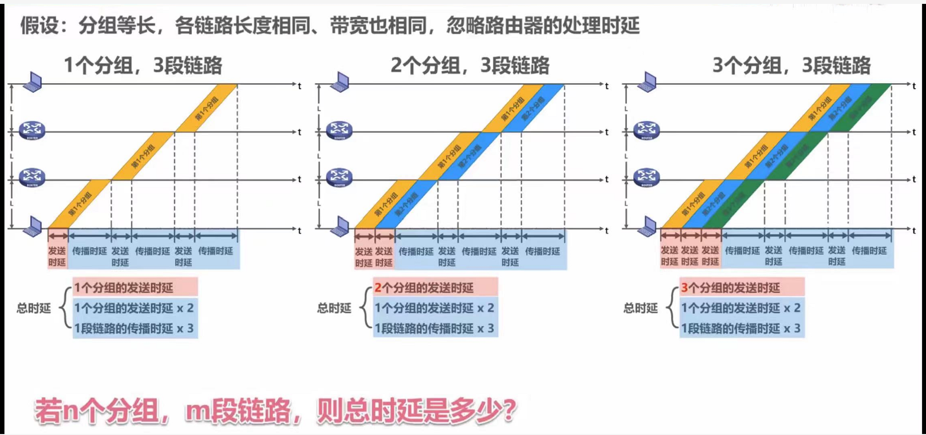
End-to-end delay
A
B

Slide 61
Exercise-2 (end-to-end delay)
L
R
R
R
Message switching and Packet switching: Entire message or packet must arrive at router before it can be transmitted on next link: store and forward
Calculate the end-to-end delay of message switching and packet switching
Example:
L = 7.5 Mbits
R = 1.5 Mbps
t_{prop} : propagation delay of each link
Divide the message into 5000 small packets: l=1.5 kbits

Slide 62
Exercise-3 (end-to-end delay)
The message to be sent is x (bits) in total. There are k links from the source to the destination. The propagation delay of each link is d(s) and the bandwidth is R(bps). In circuit switching, the circuit establishment time is s(s). In packet switching, the message can be divided into several packets with p(bits) length. It is assumed that the processing time and queuing time of the message/packets at each node are ignored.
Q: under what conditions is the end-to-end delay of circuit switching greater than that of packet switching?

Slide 63
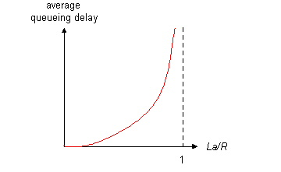

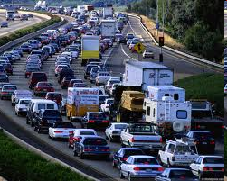
Queueing delay (revisited)
R: link bandwidth (bps)
L: packet length (bits)
a: average packet arrival rate
average queueing delay
traffic intensity
= La/R
La/R ~ 0: avg. queueing delay small
La/R -> 1: avg. queueing delay large
La/R > 1: more “work” arriving
than can be serviced, average delay infinite!
La/R ~ 0
La/R -> 1
* Check online interactive animation on queuing and loss

Slide 64
Packet loss
queue (aka buffer) preceding link in buffer has finite capacity
when packet arrives to full queue, packet is dropped (aka lost)
lost packet may be retransmitted by previous node, by source end system, or not at all
buffer
(waiting area)
A
packet being transmitted
B
packet arriving to
full buffer is lost
* Check out the Java applet for an interactive animation on queuing and loss

Slide 65
Chapter 1: roadmap
1.1 What is the Internet?
1.2 Network edge
hosts, access network, physical media
1.3 Network core
packet switching, circuit switching, network structure
1.4 Delay & loss in packet-switched networks
1.5 Protocol layers, Service models
1.6* Internet history
Notes:
65

Slide 66


What’s a protocol?
A human protocol and a computer network protocol:
Hi
TCP connection
request
Hi
TCP connection
response
Got the
time?
GET http://gaia.cs.umass.edu/kurose_ross
2:00
<file>
time
Q: other human protocols?

Slide 67
What’s a protocol?
Human protocols:
“what’s the time?”
“I have a question”
introductions
Network protocols:
computers (devices) rather than humans
all communication activity in Internet governed by protocols
Rules for:
… specific messages sent
… specific actions taken when message received, or other events
Protocols define the format, order of messages sent and received among network entities, and actions taken on message transmission, receipt

Slide 68
3 elements of a protocol
Syntax: Defines how to do it
Semantics: Defines what it is
Timing: Defines the order and speed
Example:
1010110110111011010011001110…
Source Address
Destination Address
Data

Slide 69
Protocol “layers”
Networks are complex,
with many “pieces”:
hosts
routers
links of various media
applications
protocols
hardware, software
Question:
is there any hope of organizing structure of network?
…. or at least our discussion of networks?

Slide 70
Organization of air travel
ticket (purchase)
baggage (check)
gates (load)
runway takeoff
airplane routing
ticket (complain)
baggage (claim)
gates (unload)
runway landing
airplane routing
airplane routing
a series of steps

Slide 71
Layering of airline functionality
ticket (purchase)
baggage (check)
gates (load)
runway (takeoff)
airplane routing
ticket (complain)
baggage (claim
gates (unload)
runway (land)
airplane routing
ticket
baggage
gate
takeoff/landing
airplane routing
airplane routing
airplane routing
departure
airport
intermediate air-traffic
control centers
arrival
airport
layers: each layer implements a service
via its own internal-layer actions
relying on services provided by layer below

Slide 72
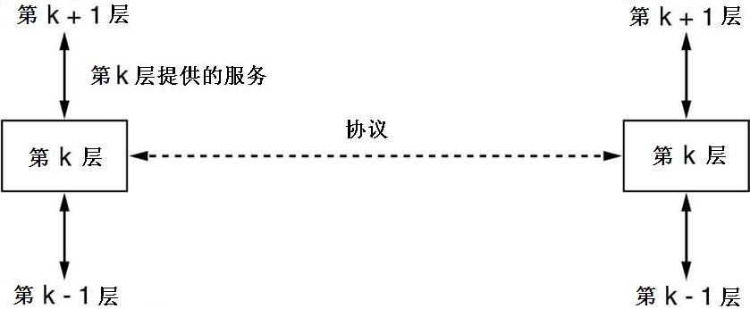
Layering of airline functionality
layers: each layer implements a service
via its own internal-layer actions
relying on services provided by layer below

Slide 73
Why layering?
dealing with complex systems:
explicit structure allows identification, relationship of complex system’s pieces
layered reference model for discussion
modularization eases maintenance, updating of system
change of implementation of layer’s service transparent to rest of system
e.g., change in gate procedure doesn’t affect rest of system
layering considered harmful?
Notes:
显式结构允许识别复杂系统各部分的关系
模块化简化了系统的维护和更新
对系统其余部分透明的层服务的实现更改
例如，门程序的更改不会影响系统的其余部分
分层被认为有害吗？

Slide 74
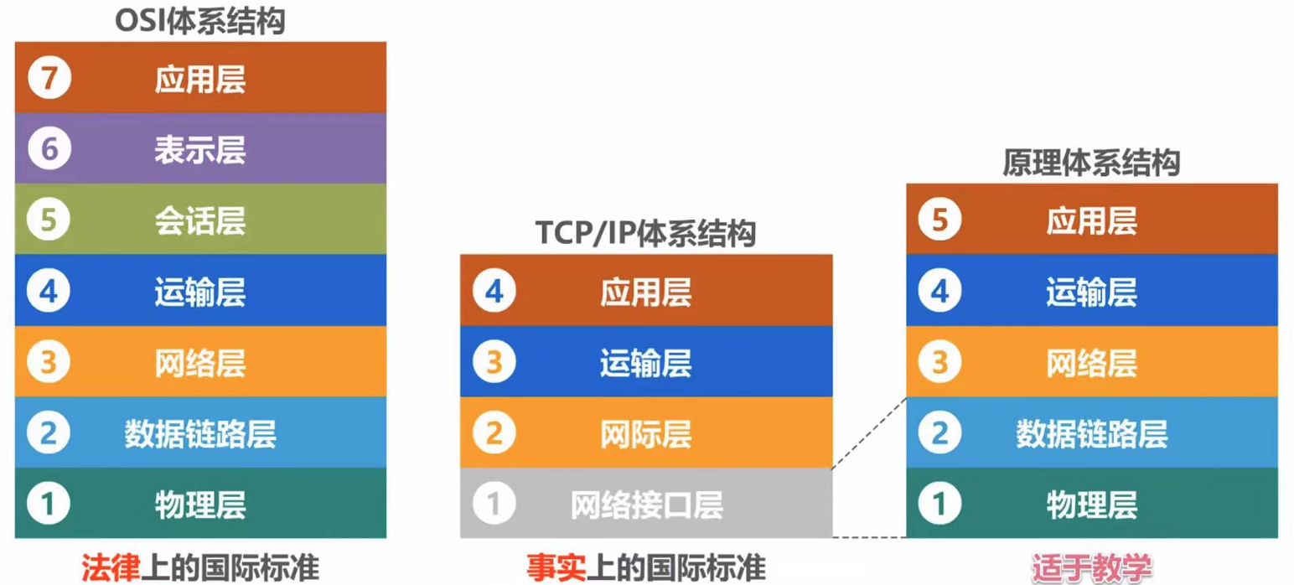
Network architecture
OSI/RM
Internet RM

Slide 75
Internet protocol stack
application: supporting network applications
FTP, SMTP, HTTP
transport: process-process data transfer
TCP, UDP
network: routing of datagrams from source to destination
IP, routing protocols
link: data transfer between neighboring network elements
Ethernet, 802.111 (WiFi), PPP
physical: bits “on the wire”
application
transport
network
link
physical

Slide 76
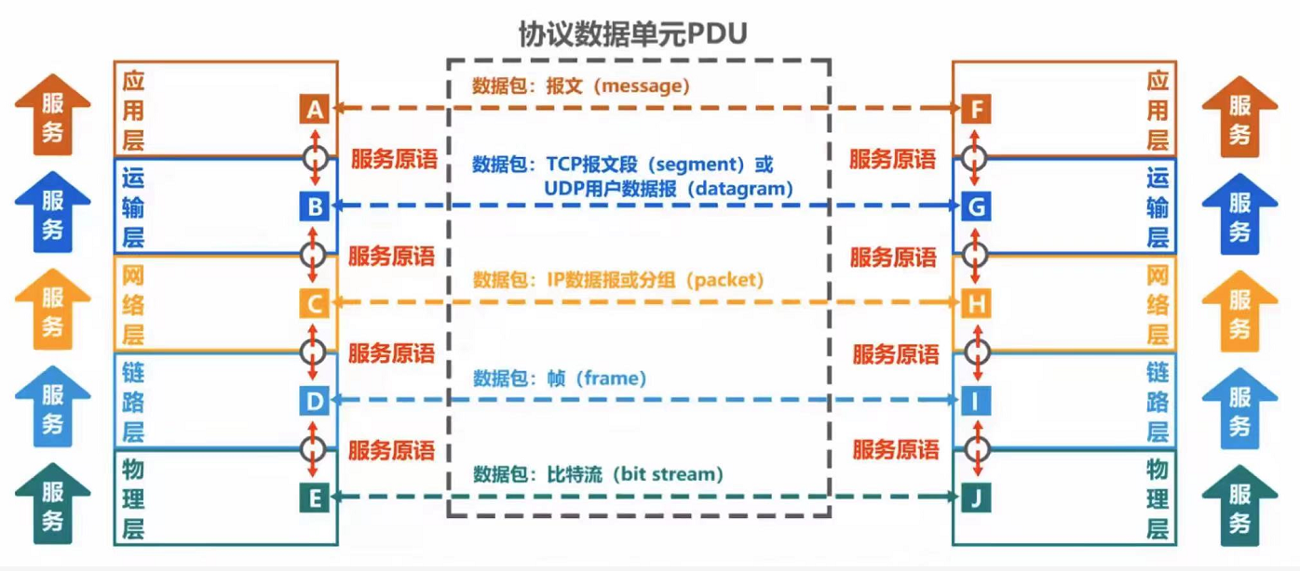
Terminology of network architecture
Entity: hardware and software process that can send and receive information.
Service: the function provided by the lower layer to the upper layer
Service access point (SAP): places where entities of two adjacent layers interact Service primitives: commands to be exchanged during the interaction between adjacent layers

Slide 77
Encapsulation
source
message
M
application
transport
network
link
physical
segment
H_{t}
M
H_{t}
datagram
H_{n}
H_{n}
H_{t}
M
frame
H_{l}
H_{n}
H_{t}
M
link
physical
switch
destination
H_{n}
H_{t}
M
network
link
physical
M
application
transport
network
link
physical
H_{l}
H_{n}
H_{t}
M
H_{n}
H_{t}
M
H_{t}
M
H_{n}
H_{t}
M
H_{l}
H_{n}
H_{t}
M
router

Slide 78
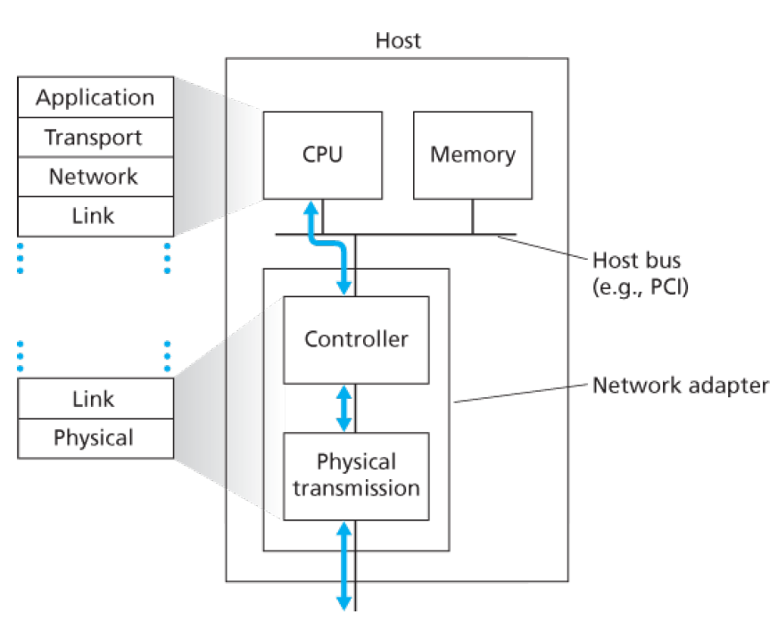
Internet protocol stack
application
transport
network
link
physical

Slide 79
Exercise-4
In the OSI model, the first bottom-up level to provide end-to-end services is ( )
data link layer B. transport layer C. session layer D. application layer
2. Among the following options, which is not described in the network architecture is ( )
A. layers in the network B. protocols used by each layer
C. internal implementation details of the protocols
D. functions that must be completed by each layer
3. In the TCP / IP reference model, what directly provides services for the application layer is ( )
A. presentation layer B. transmission layer C. network layer D. network interface layer

Slide 80
Exercise-4
4. Assuming that the application layer in the ISO/OSI reference model wants to send 400B data (without splitting), except the physical layer and application layer, all other layers introduce 20B additional overhead when packaging PDU, the transmission efficiency of the application layer is about ( )
A.80% B.83% C.87% D.91%

Slide 81
Chapter 1: roadmap
1.1 What is the Internet?
1.2 Network edge
hosts, access network, physical media
1.3 Network core
packet switching, circuit switching, network structure
1.4 Delay & loss in packet-switched networks
1.5 Protocol layers, Service models
1.6* Internet history
Notes:
81

Slide 82
Internet History
1961-1972: Early packet-switching principles
1961: Kleinrock - queueing theory shows effectiveness of packet-switching
1964: Baran - packet-switching in military nets
1967: ARPAnet conceived by Advanced Research Projects Agency
1969: first ARPAnet node operational
The first link in the
Internet backbone
SRI
crash
UCLA
The first message: LO!
What was the first message ever sent on the Internet? (LOGIN)
We sent an “L” - did you get the “L”? YEP!
We sent an “O” - did you get the “O”? YEP!
We sent a “G” - did you get the “G”?

Slide 83
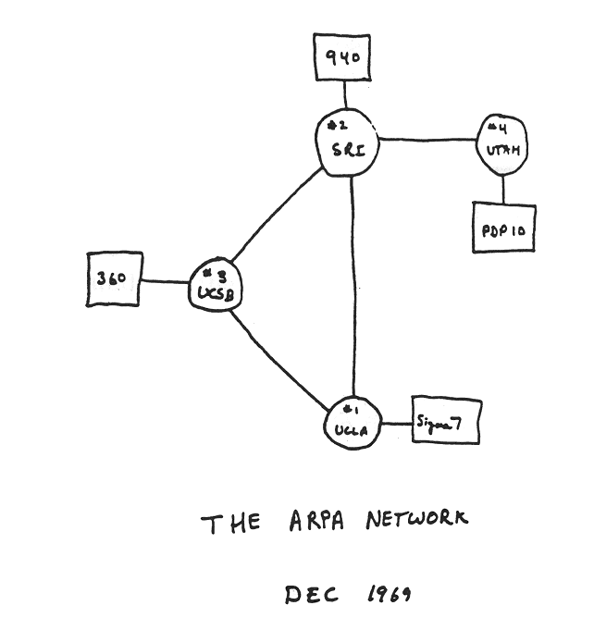
Internet History
1961-1972: Early packet-switching principles
The Internet is Born! at UCLA on October 29, 1969
What it looked like at the end of 1969
1972:
ARPAnet public demonstration
NCP (Network Control Protocol) first host-host protocol
First e-mail program
ARPAnet has 15 nodes

Slide 84
Internet History
1972-1980: Internetworking, new and proprietary nets
1970: ALOHAnet satellite network in Hawaii
1974: Cerf and Kahn - architecture for interconnecting networks
1976: Ethernet at Xerox PARC
ate70’s: proprietary architectures: DECnet, SNA, XNA
late 70’s: switching fixed length packets (ATM precursor)
1979: ARPAnet has 200 nodes
Cerf and Kahn’s internetworking principles:
minimalism, autonomy - no internal changes required to interconnect networks
best effort service model
stateless routers
decentralized control
define today’s Internet architecture

Slide 85
Internet History
1980-1990: new protocols, a proliferation of networks
1983: deployment of TCP/IP
1982: SMTP e-mail protocol defined
1983: DNS defined for name-to-IP-address translation
1985: FTP protocol defined
1988: TCP congestion control
New national networks: Csnet, BITnet, NSFnet, Minitel
100,000 hosts connected to confederation of networks

Slide 86
Internet History
1990, 2000’s: commercialization, the Web, new apps
Early 1990’s: ARPAnet decommissioned
1991: NSF lifts restrictions on commercial use of NSFnet (decommissioned, 1995)
Early 1990s: Web
Hypertext [Bush 1945, Nelson 1960’s]
HTML, HTTP: Berners-Lee
1994: Mosaic, later Netscape
Late 1990’s: commercialization of the Web
Late 1990’s – 2000’s:
More killer apps: instant messaging, P2P file sharing
Network security to forefront
Est. 50 million host, 100 million+ users
Backbone links running at Gbps

Slide 87

Internet History
Recent Developments
High-speed access networking
10Gbits Ethernet
Wireless access (UWB, WiMAX, 4G, etc.)
Security
Internet
Wireless(5G)
Other networking
Industrial internet
Internet of things
……

Slide 88
Introduction: Summary
Covered a “ton” of material!
Internet overview
What’s a protocol?
Network edge, core, access network
Packet-switching versus circuit-switching
Performance: loss, delay
Layering and service models
History
You now have:
Context, overview, “feel” of networking
More depth, detail to follow!

Slide 89
Homework
P95~97
R4,R13,R18
R23,R25
P99~101
P6,P8,P10,P14

